Slide 1



PCCDA 2023
International Conference on Paradigms of Communication, Computing and Data Analytics (PCCDA 2023)
22-23 April 2023
Audio Classification of Emergency Vehicle Sirens Using Recurrent Neural Network Architectures
Paper ID: 25 Track: Signal & Image Processing
Arya Shah, Amanpreet Singh, Artika Singh
Department of Computer Engineering
NMIMS University, MPSTME - Mumbai
Presented by
Arya Shah
Amanpreet Singh
Notes:
A very good afternoon to the esteemed chairs and fellow participants. I am Amanpreet Singh and today, along with my co-author, Arya Shah, we shall be presenting our research on Audio Classification of Emergency Vehicle Sirens Using Recurrent Neural Network Architectures.

Slide 2
PCCDA 2023
Roadmap
Introduction…………………………………………………………………………..…….Slide 1
Problem Statement…………………………………………………………………..…….Slide 2
Literature Review…………………………………………………………………….…….Slide 3
Methodology………….……………………………………………………………...…….Slide 4
Results………..…………………………………………………………………….……....Slide 6
Novelty Of Work………….…………………………………………………….….……….Slide 7
References………………………………………………….………………………………Slide 8
Slide No.0
Notes:
Here’s a brief roadmap of what content we shall be covering in this short presentation.

Slide 3

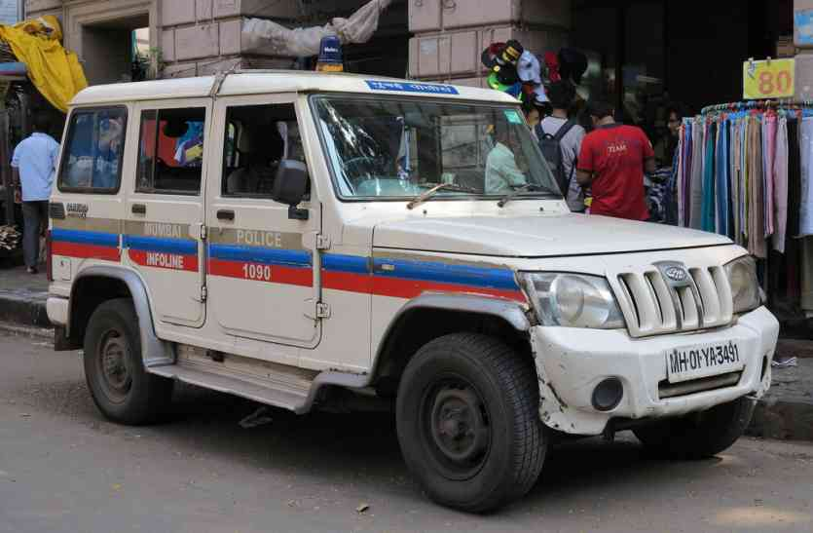
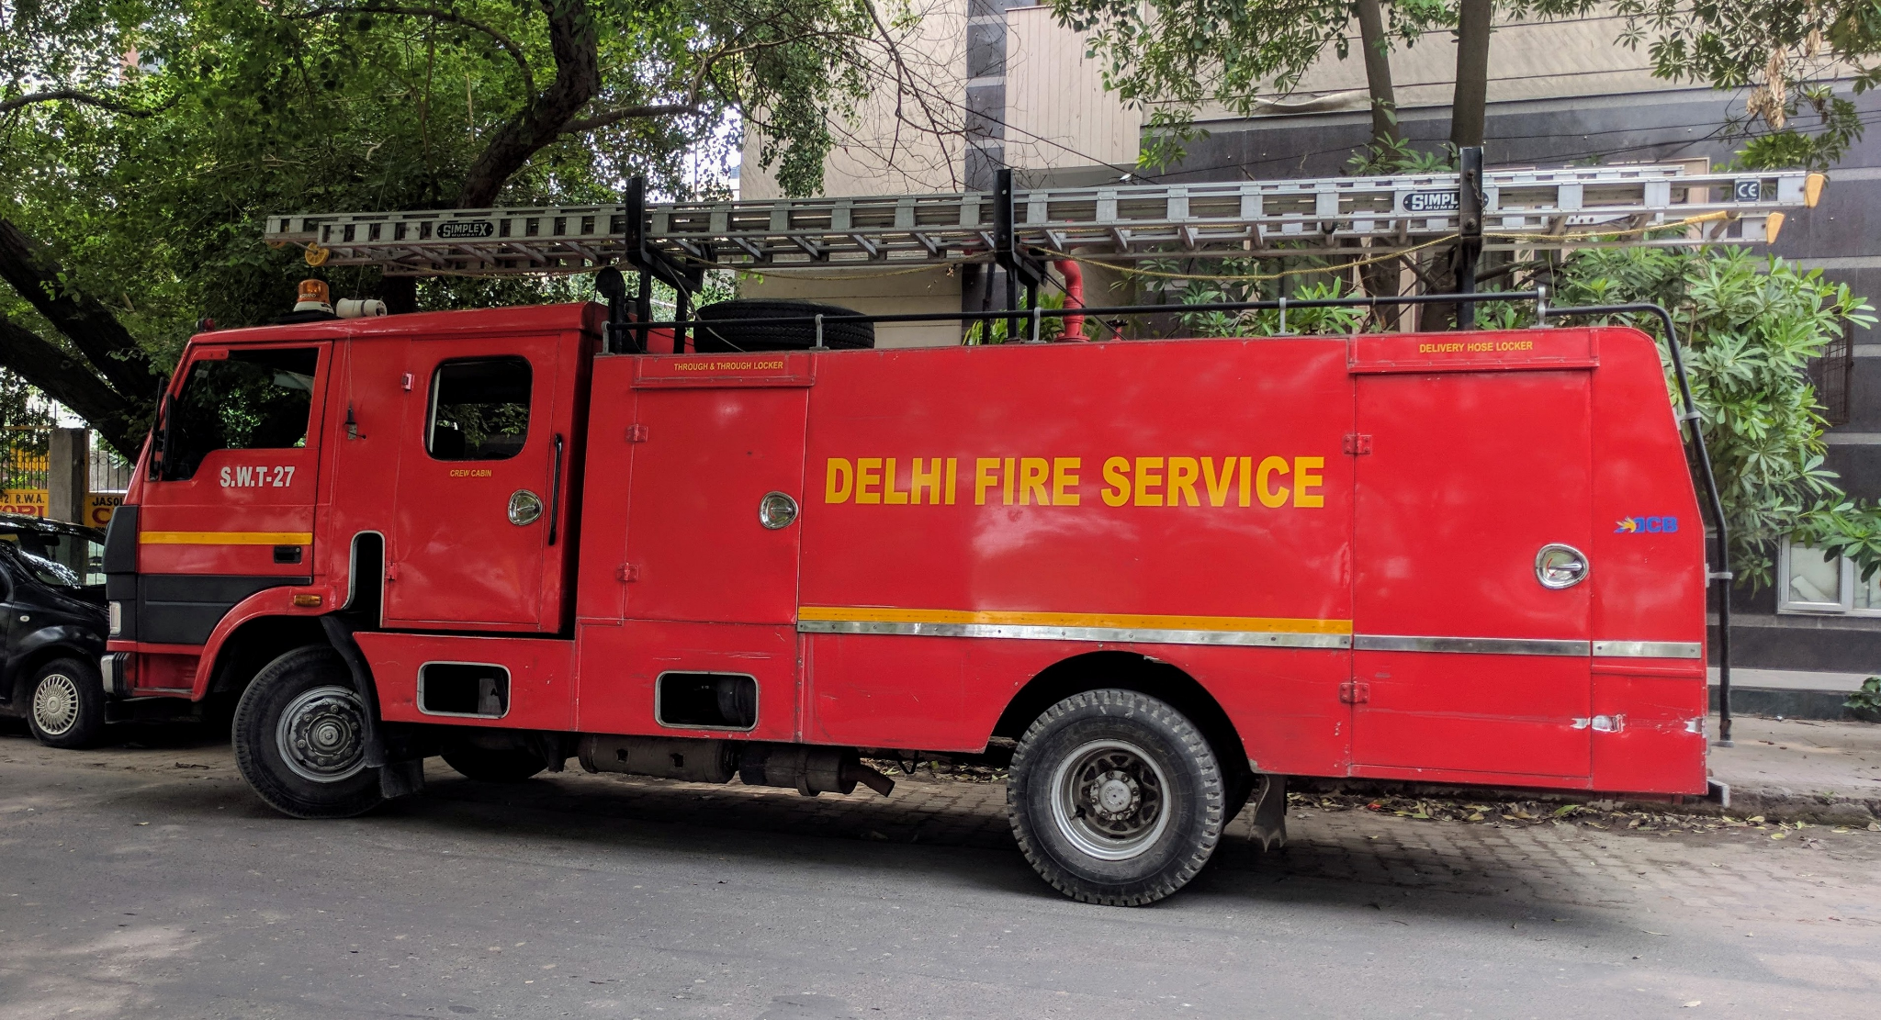
PCCDA 2023
Introduction
Emergency vehicle sirens play a crucial role in ensuring public safety and providing an audible warning to clear the way for emergency vehicles.
With the increasing number of vehicles on the roads, it is essential to have a system that can quickly and accurately identify the approach of emergency vehicles
RNNs are well-suited for audio classification problems as they are designed to process sequential data, making them well-suited to modelling the temporal dependencies in audio signals.
We discuss an audio classification framework for identifying different types of emergency vehicle which include including ambulance, fire truck, and police car sirens using Recurrent Neural Network (RNN) architectures namely LSTM and GRU along with CNNs
Slide No.1
Notes:
Beginning with the introduction, It is important to understand that Emergency vehicles, such as ambulances, police cars, and fire trucks, rely on their sirens to alert drivers and pedestrians of their presence
These sirens help clear the way for them to reach their destination as quickly and safely as possible.
With the increasing number of vehicles on road at present, there is a need for a system that can identify the approach of emergency vehicles in proximity.
So, This type of system can be incorporated into self driving cars to help detect these emergency vehicles.
As we shall discuss in the upcoming slides of literature review, it is observed that RNNs are very well suited for such tasks due to their ability to process sequential data and modelling temporal dependencies in audio signals.
We therefore discuss and introduce an audio classification framework that identifies emergency vehicle sirens of namely- ambulances, police vehicles and fire-fighting trucks.

Slide 4
PCCDA 2023
Problem Statement
To demonstrate the potential of RNN architectures in solving real-world audio classification problems and contribute to the concept of developing real-time systems to alert road users of the approach of emergency vehicles.
Slide No.2
Notes:
Hence, based on the preliminary research, we define the problem statement as: “To demonstrate the potential of RNN architectures in solving real-world audio classification problems and contribute to the concept of developing real-time systems to alert road users of the approach of emergency vehicles.”

Slide 5
PCCDA 2023
Literature Review
Paper Title | Authors | Key Takeaways | Results
Urban Sound Classification using Long Short-Term Memory Neural Network | I. Lezhenin et al. | The paper address the difficulties in performing environmental sound classification due to its unstructured nature by taking into account the spectro-temporal patterns of the data. It is worthwhile to note that the method discussed in the paper could not outperform the GoogleNet network using the mel spectogram, MFCC and CRP images as input as compared to only mel spectogram features used in the paper. | Accuracy: 84.25%
A New Deep CNN Model for Environmental Sound Classification | F. Demir et al. | F. Demir et al. extracted deep features using fully connected layer of the proposed CNN which is trained on Spectogram images. The feature vector is then conveyed as input to a random subspaces KNN Ensemble Classifier for testing performance. | Accuracy: 96.23%
Urban Sound Classification Using Convolutional Neural Network and Long Short Term Memory Based on Multiple Features | J. K. Das et al. | Proposed that LSTM based approach for sound classification shows better results as compared to previously known approaches of CNN, ANN, R-CNN. The state-of-the-art results in the feature were achieved through stacking the two features of Mel Frequency Cepstral-Coefficients and Chroma Short Term Fourier Transform which was then used in the LSTM network | Accuracy: 97.81%
Environmental sound classification based on pitch shifting | W. Zhao and B. Yin. | CNN can classify such sounds, however data singularity and unequal sample length cause overfitting and poor accuracy Authors offer wave-form stretching, pitch shifting, and audio augmentation to overcome the unequal audio duration problem and prevent over-fitting An improved LeNet network classifies Log-Mel features | Accuracy: 95.65%
Deep learning based urban sound classification and ambulance siren detector using spectrogram | D. Pramanick et al. | Suggest a simpler yet effective architecture for siren and other urban sound detection Scalogram, Fourier decomposition and Mel-spectogram sound-to-image transformation methods have been discussed The authors' CNN with mel-spectrogram feature outperformed GoogleNet, ALexNet, and VGG16 | Accuracy: 88.66%
Slide No.3
Notes:
As part of our research, we reviewed a fair amount of existing literature consisting of various methodologies and techniques employed to address the problem of audio signal classification. Out of the approximate 23 to 25 papers that we reviewed, it was observed that certain features are extracted from the audio which serves as the input data for CNN and RNN models for classification.
The research conducted was roughly divided into into two broad categories- one was to extract features and represent them as images i.e spectrograms and alike while the second method was to extract numeric features.
Some popular audio extraction methods that we came across include: MFCCs, Chroma Short Term Fourier Transforms, Scalograms, Log-Mel Features to name a few.
While the popular approaches include experimentation with various Convolutional Neural Network Architectures, Long Short Term Memory Networks.
The common problems that previous authors have come across include addressing the unstructured nature of the data, identifying spectro-temporal patterns, data singularity, unequal sample lengths which cause overfitting and poor accuracy and the need for data augmentation to solve majority of the issues stated right now.

Slide 6
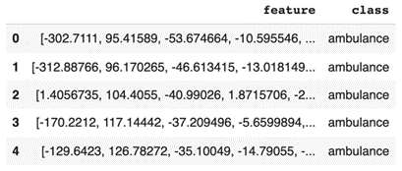
PCCDA 2023
Methodology
Audio content scraped from YouTube was labelled into ambulance, firetruck, police and traffic classes. The audio recordings in the dataset are sampled at 48 kHz and uniformly kept 3s long.
We introduce superimposing traffic noise to the audio file as a part of augmentation of dataset. The augmented dataset was further normalized with a peak value of 100% using the simple peak level normalization method. The volume level was set to 6 dB. The final dataset contains 1675 tagged audio recordings.
To extract the features of the audio signals, we used the Mel Frequency Cepstral Coefficient representation with the help of Librosa, an open source Python library for audio analysis. The number of MFCC features extracted from the wave signal were set to 80. The complete features along with its corresponding class of audio signal were dumped into a pickle file that was later used as input to the model.
Data Procurement & Creation
Data Augmentation
Feature Extraction
Model Training
Model Evaluation
Slide No.4
Notes:
In order to build this model, we started with data procurement and creation where we collected sounds of ambulance, police, firetruck and traffic. These audio file were sampled at 48khz and were 3sec long.
For data augmentation, we superimposed traffic sound in to the ambulance, firetruck and police siren sounds which helped use train with real world scenarios. These files were further normalized with a peak value of 100% using simple peak level normalization method. The final dataset had 1675 audio files.
Then for feature extraction, we used the Mel Frequency Cepstral Coefficient representation with the help of Librosa. In total, 80 features were extracted from the wave signal. Then the complete features along with its corresponding class of audio signal were dumped into a pickle file that was later used as input to the model.

Slide 7
PCCDA 2023
Methodology
Train Test Split = 80:20 | Original Dataset |  | Augmented Dataset
Train | 661 |  | 1340
Test | 166 |  | 334
Total | 827 |  | 1675
Parameter | Set value for all models
Batch Size | 64
Optimizer | Adam
Activation function. | ReLu
Loss Function | binary_crossentropy
Epochs | 400
Before training the model on extracted set of input features, the complete extracted features dataset was split into Train and Test dataset individually.
After splitting the dataset into training and testing set, the training set is used as input for the three models- CNN, LSTM and GRU for training purpose. The model training is done using Google Colab Notebooks and the TensorFlow library along with Keras as backend is used for creating CNN and RNN Networks- LSTM and GRU.
Slide No.5
Notes:
For the CNN Model, we use two 1D-Convolutional Layers of filter size 3 with ker-nel size as 13 and filter size 16 with kernel size 11 respectively. The optimizer used was Adam with the activation function as ReLu. The dropout rate was maintained at 0.3. Following which a 1D Global Max Pooling Layer along with a Dense Layer with Softmax activation has been used. The metrics used for evaluation during model train-ing is Accuracy and the loss function employed is binary_crossentropy. Training for 400 epochs with a batch size of 64 was set.
For the LSTM model, we use one LSTM layer with 28 hidden units, and the return condition has been set to "true." The dropout rate was maintained at 0.3. Following that, the model contains two time-distributed dense layers, where the first layer has a size of 256 and the second has a size of 512. In both layers, ReLU has been used as the activation function, and the optimizer used was Adam. After being used as input by the flattening layer, the output of the time-distributed dense layer is then sent on to the last layer, which is the dense layer. The evaluation-metric during model training is accuracy, and the loss-function considered is binary cross-entropy. The model trained for 200 epochs with a batch-size of 64.
In the GRU Model implementation, the GRU layer of size 128 along with the dropout rate of 0.5 is added. Following which we have introduced two dense layers of size 64 with activation ReLu and the output layer set to the number of classes i.e 4 with the softmax activation function. The optimizer used is Adam, the loss function is maintained as binary_crossentropy and the model training metric used is that of Accu-racy. The GRU-model trained for 1500 epochs with 64 set as the batch size.

Slide 8
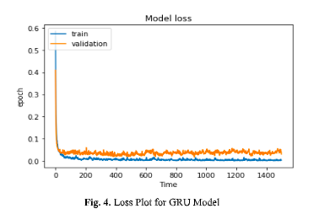
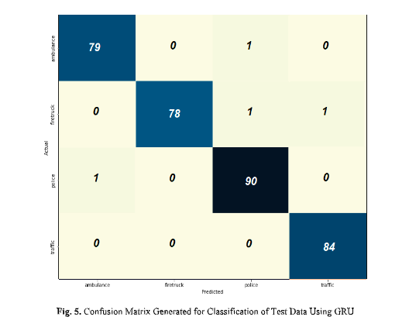
PCCDA 2023
Results
Model | Original Dataset |  | Augmented Dataset
 | Train-set Accuracy | Test-set Accuracy | Train-set Accuracy | Test-set Accuracy
CNN | 100% | 97.59% | 99.85% | 92.84%
LSTM | 100% | 98.80% | 100% | 97.61%
GRU | 100% | 98.19% | 99.70% | 98.81%
Slide No.6
Notes:
On evaluating the models, both on the original and augmented data, undoubtedly the augmented dataset fit well with the model architectures. It was observed that the GRU based Network Architecture performed well overall out of the CNN and LSTM Networks. The accuracy achieved by the proposed framework outperforms previous literature reviewed and is close to the previously stated state-of-the-art models.

Slide 9
PCCDA 2023
Novelty Of The Work
Work Done | Description
sireNNet - Emergency Vehicle Siren Classification Dataset For Urban Applications | An audio dataset for classifying sirens of emergency vehicles such as fire truck, ambulance and police vehicles along with an additional class for traffic noise. The dataset consists of the following 4 classes with the distribution of data within them as follows: 1. Ambulance: 400 files 2. Police: 454 files 3. Firetruck: 400 files 4. Traffic: 421 files
Comparison between the three models- CNN, LSTM and GRU | Based on the 3 models trained- CNN, LSTM and GRU, the evaluation metrics were mentioned with the comparison done between augmented and original set of data.
Published a novel dataset - “sireNNet-Emergency Vehicle Siren Classification Dataset For Urban Applications” to approach the problem statement
Addressed the limited research done in the area of Emergency Vehicle Siren Detection
Slide No.7
Notes:
Finally speaking about the Novelty of the work conducted as part of the research, it is important to note that not enough research has been conducted on specific problem of audio classification of vehicle sounds as compared to popular benchmark datasets in Audio Classification domain that are primarily populated with ambient noise and domestic sound detection datasets like the Urbansound8k or the ESC-50 Datasets or the DCASE datasets which primarily address acoustic and bioacoustic sound detection.
So, keeping in mind the limited research done, we published a novel dataset named: “sireNNet-Emergency Vehicle Siren Classification Dataset For Urban Applications” to approach the problem statement and have made it open access for future researchers.
We also explored and confirmed the extension and utility of RNN based architectures as compared to CNN based architecture for the use case of audio classification. By providing the comparative study, we also prove the fact that data augmentation and feature engineering methods are crucial for achieving stat-of-the-art accuracies.

Slide 10
PCCDA 2023
Conclusion & Future Work
CNN can classify audio signals, however data singularity and unequal sample length cause overfitting and poor accuracy.
RNN based architectures outperform CNNs and are better equipped to identify and classify temporal dependencies in audio signals.
In future, we plan to use Attention mechanisms in RNN-based models to improve their performance on audio classification tasks.
Experiment with Hybrid Network Architectures like Fused CNN-LSTM, CNN-GRU.
Transformers, originally introduced in natural language processing, have also been applied to audio classification tasks.
Slide No.7
Notes:
An attention mechanism allows the model to focus on different parts of the input sequence, which can be particularly useful for capturing important features in audio data
A recent study by Han et al. (2021) proposed a transformer-based model for acoustic scene classification, which achieved state-of-the-art performance on the DCASE 2018 task.

Slide 11
PCCDA 2023
References
[1] Shah, Arya; Singh, Amanpreet (2023), “sireNNet-Emergency Vehicle Siren Classification Dataset For Urban Applications”, Mendeley Data, V1, doi: 10.17632/j4ydzzv4kb.1
[2] I. Lezhenin, N. Bogach and E. Pyshkin, "Urban Sound Classification using Long Short-Term Memory Neural Network," 2019 Federated Conference on Computer Science and Information Systems (FedCSIS), Leipzig, Germany, 2019, pp. 57-60, doi: 10.15439/2019F185.
[3] N. Zakaria, F. Mohamed, R. Abdelghani and K. Sundaraj, "VGG16, ResNet-50, and GoogLeNet Deep Learning Architecture for Breathing Sound Classification: A Compara-tive Study," 2021 International Conference on Artificial Intelligence for Cyber Security Systems and Privacy (AI-CSP), El Oued, Algeria, 2021, pp. 1-6, doi: 10.1109/AI-CSP52968.2021.9671124.
[4] J. K. Das, A. Ghosh, A. K. Pal, S. Dutta and A. Chakrabarty, "Urban Sound Classification Using Convolutional Neural Network and Long Short Term Memory Based on Multiple Features," 2020 Fourth International Conference On Intelligent Computing in Data Sci-ences (ICDS), Fez, Morocco, 2020, pp. 1-9, doi: 10.1109/ICDS50568.2020.9268723.
[5] W. Zhao and B. Yin, "Environmental sound classification based on adding noise," 2021 IEEE 2nd International Conference on Information Technology, Big Data and Artificial Intelligence (ICIBA), Chongqing, China, 2021, pp. 887-892, doi: 10.1109/ICIBA52610.2021.9688248.
[6] K. Kumar and K. Chaturvedi, "An Audio Classification Approach using Feature extraction neural network classification Approach," 2nd International Conference on Data, Engineer-ing and Applications (IDEA), Bhopal, India, 2020, pp. 1-6, doi: 10.1109/IDEA49133.2020.9170702.
[7] W. Zhao and B. Yin, "Environmental sound classification based on pitch shifting," 2022 International Seminar on Computer Science and Engineering Technology (SCSET), Indi-anapolis, IN, USA, 2022, pp. 275-280, doi: 10.1109/SCSET55041.2022.00070.
[8] F. Demir, D. A. Abdullah and A. Sengur, "A New Deep CNN Model for Environmental Sound Classification," in IEEE Access, vol. 8, pp. 66529-66537, 2020, doi: 10.1109/ACCESS.2020.2984903.
[9] D. Pramanick, H. Ansar, H. Kumar, S. Pranav, R. Tengshe and B. Fatimah, "Deep learning based urban sound classification and ambulance siren detector using spectrogram," 2021 12th International Conference on Computing Communication and Networking Technolo-gies (ICCCNT), Kharagpur, India, 2021, pp. 1-6, doi: 10.1109/ICCCNT51525.2021.9579778.
[10] N. K, S. K. S and V. S, "Ensemble and Multi Model approach to Environmental Sound Classification," 2021 Fourth International Conference on Electrical, Computer and Com-munication Technologies (ICECCT), Erode, India, 2021, pp. 1-5, doi: 10.1109/ICECCT52121.2021.9616775.
Slide No.8

Slide 12
PCCDA 2023
References
[11] K. Hirata, T. Kato and R. Oshima, "Classification of Environmental Sounds Using Convo-lutional Neural Network with Bispectral Analysis," 2019 International Symposium on In-telligent Signal Processing and Communication Systems (ISPACS), Taipei, Taiwan, 2019, pp. 1-2, doi: 10.1109/ISPACS48206.2019.8986304.
[12] J. Lu, R. Ma, G. Liu and Z. Qin, "Deep Convolutional Neural Network with Transfer Learning for Environmental Sound Classification," 2021 International Conference on Computer, Control and Robotics (ICCCR), Shanghai, China, 2021, pp. 242-245, doi: 10.1109/ICCCR49711.2021.9349393.
[13] U. Singh et al., "Polyphonic Sound Event Detection and Classification using Convolu-tional Recurrent Neural Network with Mean Teacher," 2021 12th International Confer-ence on Computing Communication and Networking Technologies (ICCCNT), Kharag-pur, India, 2021, pp. 1-4, doi: 10.1109/ICCCNT51525.2021.9579677.
[14] D. Wu, "An Audio Classification Approach Based on Machine Learning," 2019 Interna-tional Conference on Intelligent Transportation, Big Data & Smart City (ICITBS), Chang-sha, China, 2019, pp. 626-629, doi: 10.1109/ICITBS.2019.00156.
[15] E. B. Evangelista, F. Guajardo and T. Ning, "Classification of Abnormal Heart Sounds with Machine Learning," 2020 15th IEEE International Conference on Signal Processing (ICSP), Beijing, China, 2020, pp. 285-288, doi: 10.1109/ICSP48669.2020.9320916.
[16] G. Mkrtchian and Y. Furletov, "Classification of Environmental Sounds Using Neural Networks," 2022 Systems of Signal Synchronization, Generating and Processing in Tele-communications (SYNCHROINFO), Arkhangelsk, Russian Federation, 2022, pp. 1-4, doi: 10.1109/SYNCHROINFO55067.2022.9840922.
[17] A. Ahmed, Y. Serrestou, K. Raoof and J. -F. Diouris, "Sound event classification using neural networks and feature selection based methods," 2021 IEEE International Confer-ence on Electro Information Technology (EIT), Mt. Pleasant, MI, USA, 2021, pp. 1-6, doi: 10.1109/EIT51626.2021.9491869.
[18] F. Paissan, A. Ancilotto, A. Brutti and E. Farella, "Scalable Neural Architectures for End-to-End Environmental Sound Classification," ICASSP 2022 - 2022 IEEE International Conference on Acoustics, Speech and Signal Processing (ICASSP), Singapore, Singapore, 2022, pp. 641-645, doi: 10.1109/ICASSP43922.2022.9746093.
[19] L. Vujošević and S. Đukanović, "Deep learning-based classification of environmental sounds," 2021 25th International Conference on Information Technology (IT), Zabljak, Montenegro, 2021, pp. 1-4, doi: 10.1109/IT51528.2021.9390124.
[20] R. Li, B. Yin, Y. Cui, Z. Du and K. Li, "Research on Environmental Sound Classification Algorithm Based on Multi-feature Fusion," 2020 IEEE 9th Joint International Infor-mation Technology and Artificial Intelligence Conference (ITAIC), Chongqing, China, 2020, pp. 522-526, doi: 10.1109/ITAIC49862.2020.9338926.
[21] C. Kroos et al., "Generalisation in Environmental Sound Classification: The ‘Making Sense of Sounds’ Data Set and Challenge," ICASSP 2019 - 2019 IEEE International Con-ference on Acoustics, Speech and Signal Processing (ICASSP), Brighton, UK, 2019, pp. 8082-8086, doi: 10.1109/ICASSP.2019.8683292.
Slide No.9

Slide 13
PCCDA 2023
THANK YOU
Slide No.9

